Slide 1

Orthogonal Relation Transforms with Graph Context Modeling for
Knowledge Graph Embedding（ACL 2020）
Yun Tang, Jing Huang, Guangtao Wang, Xiaodong He, Bowen Zhou
JD AI Research
https://arxiv.org/pdf/1911.04910.pdf
报告人：金群超

Slide 2

outline
Introduction
Proposed Method
Experimental Results
Conclusion

Slide 3
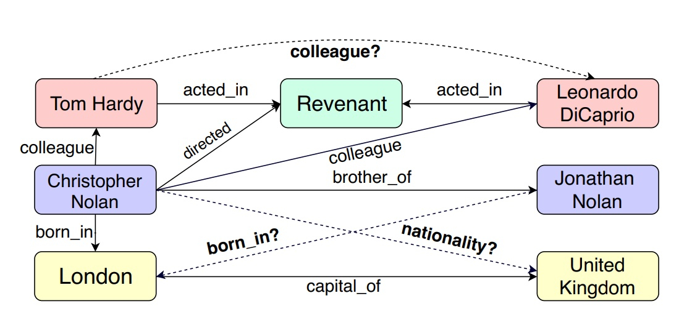
Introduction
knowledge graphs need to be updated with new facts periodically. Therefore many knowledge graph embedding methods have been proposed for link prediction that is used for knowledge graph completion.
KG Link prediction
（k，r，?）-> given(head,relation)，predict tail
（?，r，t）-> given(tail,relation)， predict head

Slide 4
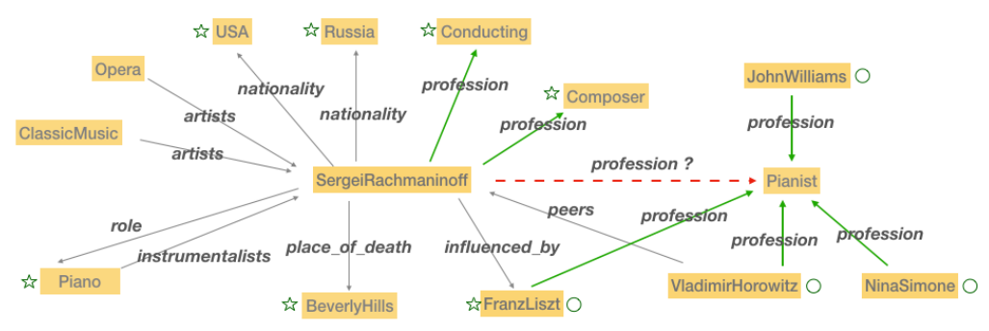
Introduction
Though much progress has been made, 1-to-N, N-to-1, and N-to-N relation predictions still remain challenging.

Slide 5
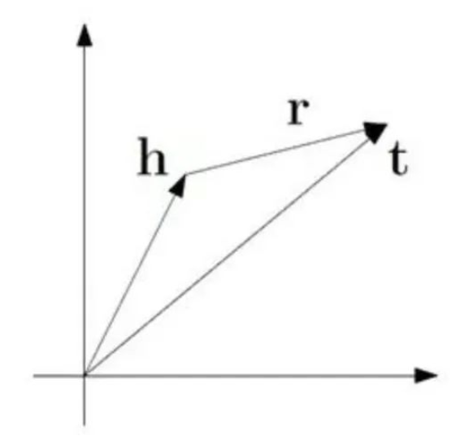
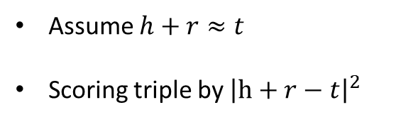
Introduction
TransE
Assume $h+r≈t$
Scoring triple by ${\left|h+r−t\right|}^{2}$
Cons
Fail to hold symmetry relation
Difficult to handle 1-to-N,N-to1 and N-to-N relations

Slide 6
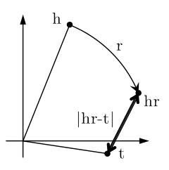
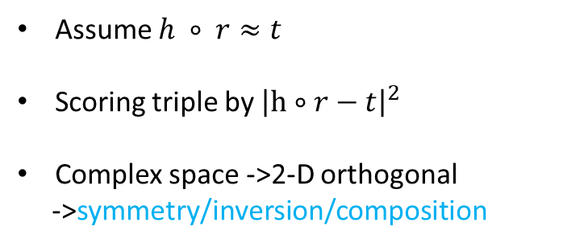
Introduction
RotatE
Assume $h ∘ r≈t$
Scoring triple by ${\left|h∘r−t\right|}^{2}$
Complex space ->2-D orthogonal
->symmetry/inversion/composition
Cons
Difficult to handle 1-to-N,N-to1 and N-to-N relations

Slide 7
Introduction
Orthogonal Transform
Orthogonality -> symmetry/inversion/composition
High-dimension orthogonal space -> more expressive than 2-D RotatE
->Orthogonal Transform Embedding(OTE)
1-to-N,N-to-1 and N-to-N relation
Add gragh context
->Graph Contextual OTE(GC-OTE)

Slide 8
Contribution
A new orthogonal transform embedding OTE,is proposed to extend RotatE from 2D space to
high dimensional space, which also models symmetry/antisymmery, inversion and compositional relation patterns;
A directed graph context modeling method is proposed to integrate knowledge graph context (including both neighboring entity nodes and relation edges) into the distance scoring function;
Experimental results of OTE on standard benchmark FB15k-237 and WN18RR datasets show consistent improvements over RotatE, the state of art distance-based embedding model, especially on FB15k-237 with many high in-degree nodes. On WN18RR our results achieve the new state-of-the-art performance.

Slide 9
outline
Introduction
Proposed Method
Experimental Results
Conclusion

Slide 10




Methods
OTE
对于Ttiple（h，r，t）
使用 $e_{h}，M_{r}，e_{t}$ 来表示头、关系和尾实体的嵌入。
$$\tilde{e_{t}}=diag(e^{−s_{r}})φ(M_{r})e_{h}$$
$$\tilde{e_{h}}=diag(e^{−s_{r}})φ(M_{r})e_{t}$$
distance score
$$d\left(\left(h,r\right),t\right)=\left\|\tilde{e_{t}}−e_{t}\right\|2$$
$$d\left(\left(h,r\right),t\right)=\left\|\tilde{e_{h}}−e_{h}\right\|2$$

Slide 11
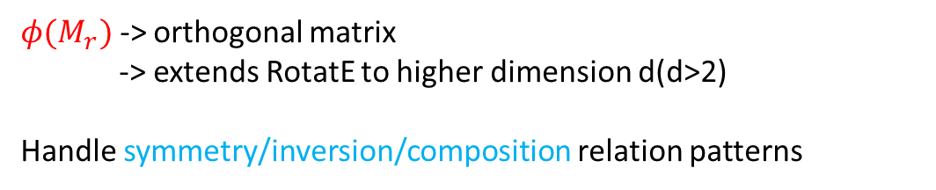

Methods
OTE
orthogonal matrix obtained by running Gram Schmidt process on $M_{r}$
$$φ(M_{r})∈R^{dxd}$$
$φ(M_{r})$ -> orthogonal matrix
-> extends RotatE to higher dimension d(d>2)
Handle symmetry/inversion/composition relation patterns

Slide 12

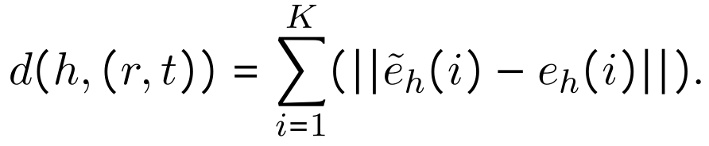
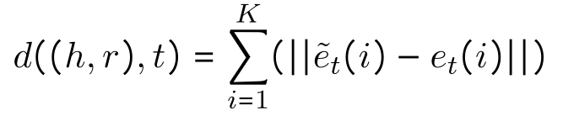
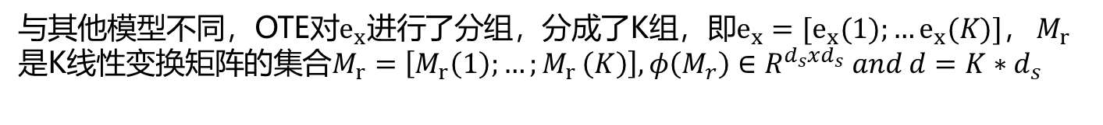
Methods
Multi-Group Embeddig
与其他模型不同，OTE对$e_{x}进行$了分组，分成了K组，即$e_{x}=[e_{x}(1);…e_{x}(K)]，$ $M_{r}$是K线性变换矩阵的集合$M_{r}=\left[M_{r}\left(1\right);…{;M}_{r}\left(K\right)\right],φ\left(M_{r}\right)∈R^{d_{s}xd_{s}} and d=K∗d_{s}$
distance score

Slide 13
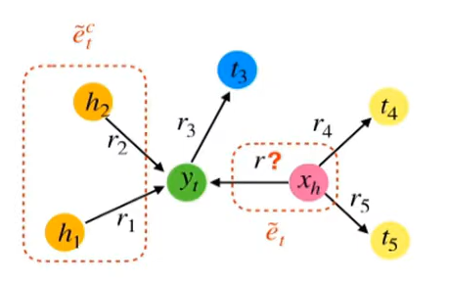
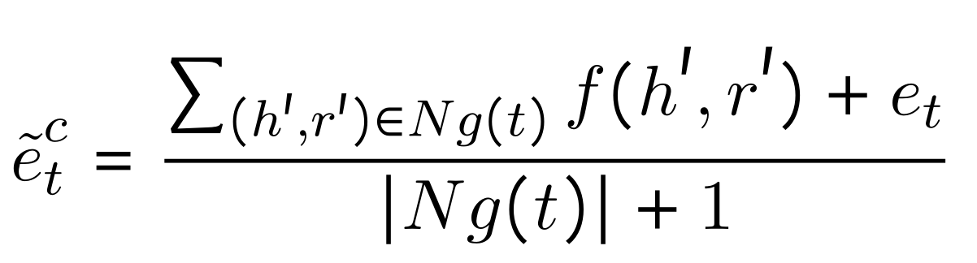
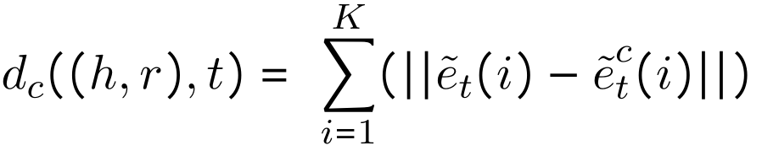
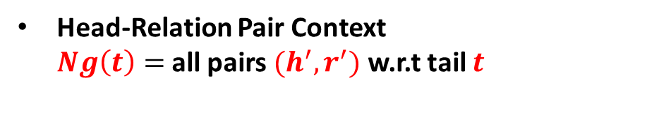
Methods
Graph Contextual OTE
Head-Relation Pair Context
$Ng\left(t\right)=$ all pairs $(h^{′},r^{′})$ w.r.t tail $t$

Slide 14
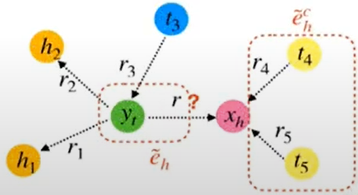
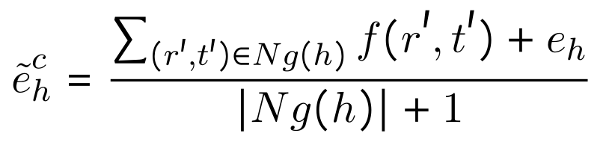
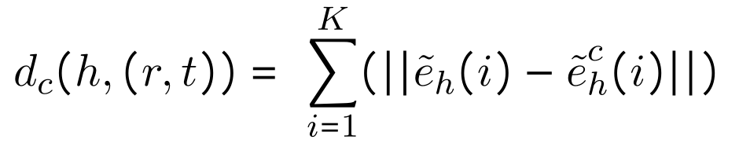
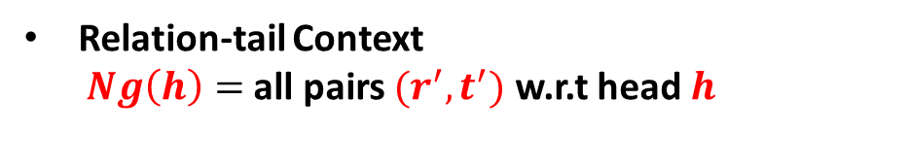
Methods
Graph Contextual OTE
Relation-tail Context
$Ng\left(h\right)=$ all pairs $(r^{′},t^{′})$ w.r.t head $h$

Slide 15
Methods
Training Objective
Distance Scoring Function over Triple (h,r,t)
$$d_{all}\left(h,r,t\right)=d\left(\left(h,r\right),t\right)+d\left(h,\left(r,t\right)\right)+d_{c}\left(\left(h,r\right),t\right)+d_{c}\left(h,(r,t)\right)$$
OTE score
GC score
Self-adversarial negative sampling loss is used to optimize
$$L= −∑p(h′, r, t′)logσ(d_{all}(h′, r, t′)−γ)−logσ(γ−d_{all}(h, r, t))$$
where γ is a fixed margin ; σ = sigmoid
(h′, r, t′) = negative triple;
p(h′, r, t′) = negative sampling weight.

Slide 16
outline
Introduction
Proposed Method
Experimental Results
Conclusion

Slide 17
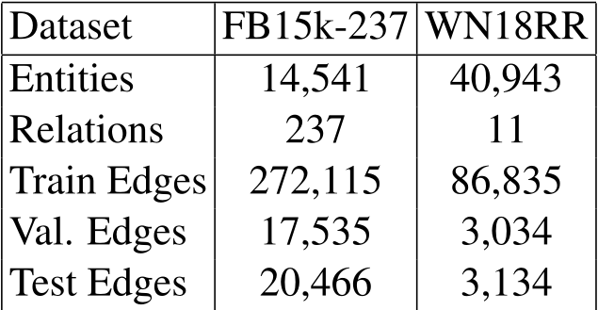
Experiments
Data Sets
FB15k-237: subset of Free base
WN18RR: a subset of WordNet
Evaluation Metrics
MRR - Mean Reciprocal Rank
Hit Ratio@1,3 and 10
Baselines
Semantic : DistMult，ComplEx，ConvE，QuatE，Tucker.
Distance based ：TransE，RotatE.
GNN based：R-GCN，SACN，A2N.

Slide 18
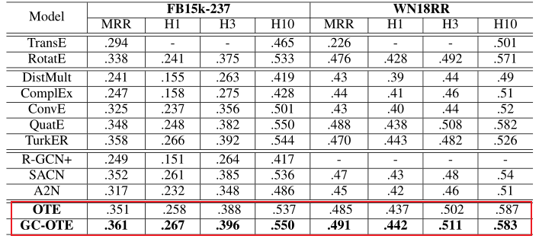
Experiments

Slide 19
outline
Introduction
Proposed Method
Experimental Results
Conclusion

Slide 20
Conclusion
OTE extends RotatE from 2-D to high dimensional space with orthogonal transforms；
Graph Context integrates graph structure into OTE
GC-OTE improves consistently over the various SOTA baselines
especially on FB15k-237 with rich graph structure
on WN18RR GC-OTE achieves the new state-of-the-art results

Slide 21


